Slide 1



Garbage game
Projekta NR 2023-1-PL01-KA210-SCH-000157500
‘’Our Actions are Our Future!’’
Upeslejas 2024

Slide 2
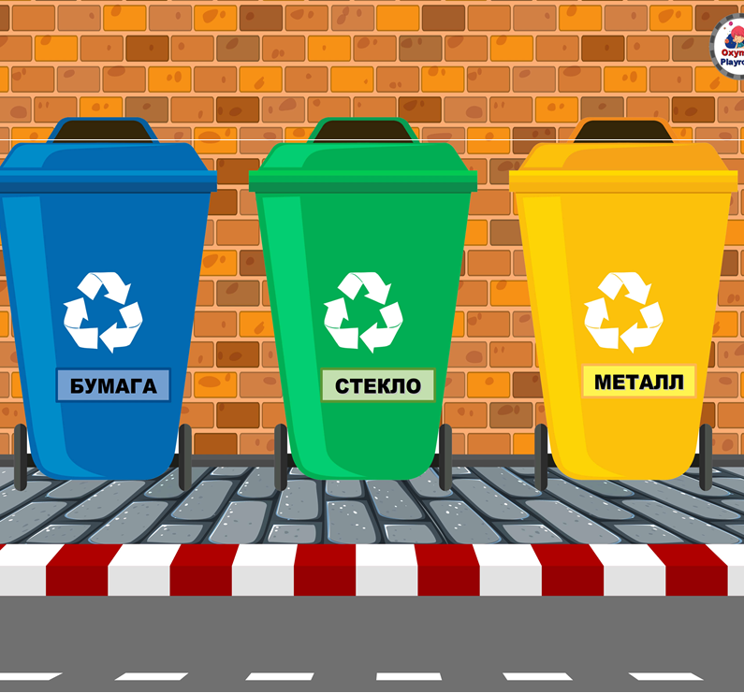

Paper
Metal
Paper
Glass

Slide 3
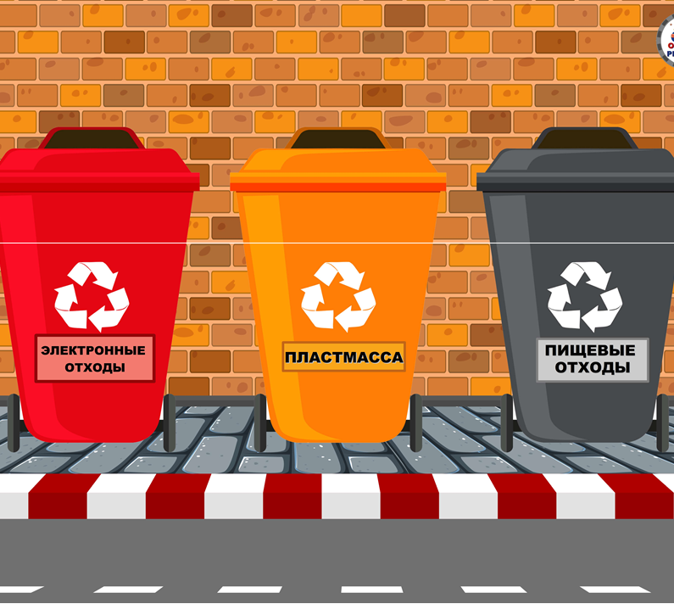
Electronic waste
Plastic
Food waste

Slide 4


Slide 5


Slide 8




